Slide 1
Intro to Trees and Binary Search Trees
Lab weds – trees. No lab next week.
When should we have a test? Need at least one more: Monday 11/21? 11/28 ? Fri 12/2?
Last day of class is Monday12/12
Final exam Fri 12/16, 830-1030AM in RB-250 (no lab final)
Linear vs. Binary search
What is a tree?
Hierarchical data structure
Binary search tree: designed for binary search
Notes:
Other examples:
Telephone numbers
IP addresses 169.226.1.10 Net and sub-net and host

Slide 2
Linear (sequential) Search
A linear search simply examines each item in the search pool, one at a time, until either the target is found or until the pool is exhausted
This approach does not assume the items in the search pool are in any particular order
It's fairly easy to understand, but not very efficient

Slide 3
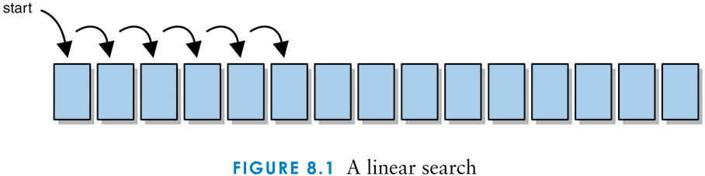
Linear search complexity: how many comparisons? best, average, worst cases?

Slide 4
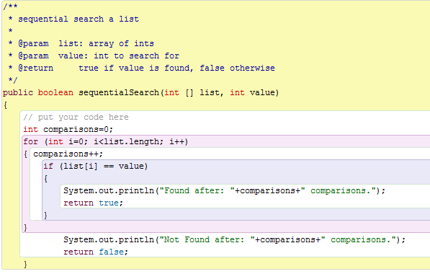

Slide 5
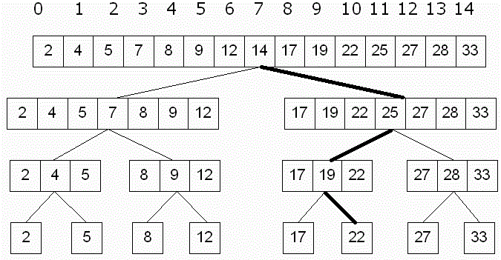
Binary Search – how it operates
What is a restriction?
Complexity: how many comparisons?

Slide 6
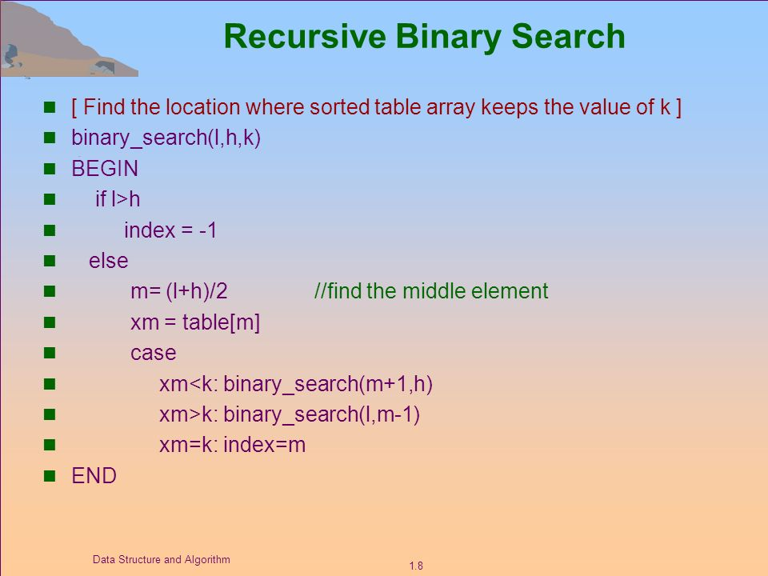

Slide 7
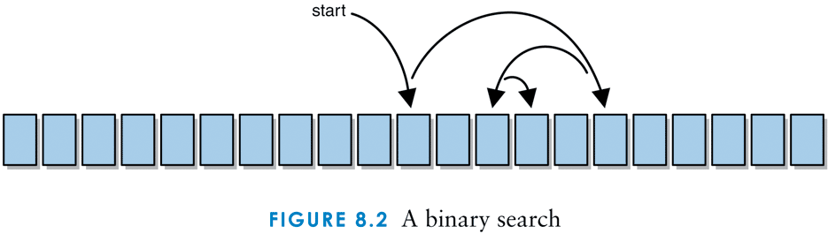
4
5
9
12
16
20
25
30
31
36
40
43
44
49
52
60
63
73
80
82
96
ITEM : _49_____________
FIRST : _________________
LAST : _________________
LOC : _________________
Notes:
4, 5, 9, 12, 16, 20, 25, 30, 31, 36, 40, 43, 44, 49, 52, 60, 63, 73, 80, 82, 96

Slide 8
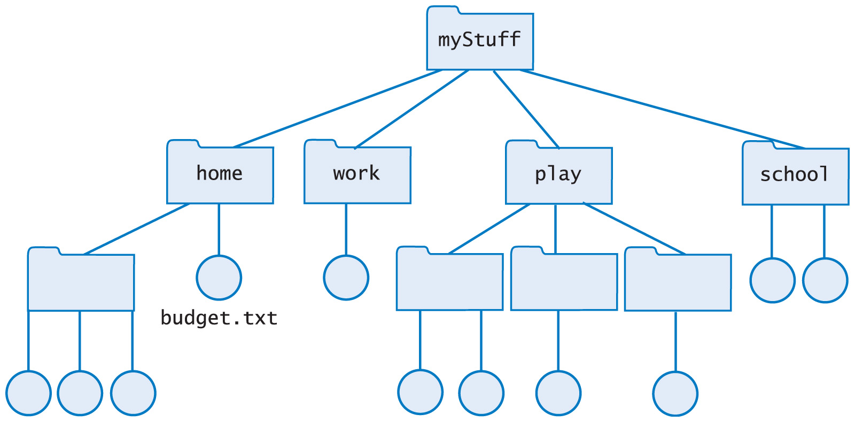
Hierarchical Organization
Example: File Directories

Slide 10
Tree Terminology
Nodes
Root
Interior
Leaf
Edges
Parent, child, sibling nodes
Ancestor, descendant
Subtree

Slide 11
Pointer (Linked) implementation of trees

Slide 12
Make Binary Search efficient for Links

Slide 13
What about duplicate data?
It does not matter, just be consistent!

Slide 14
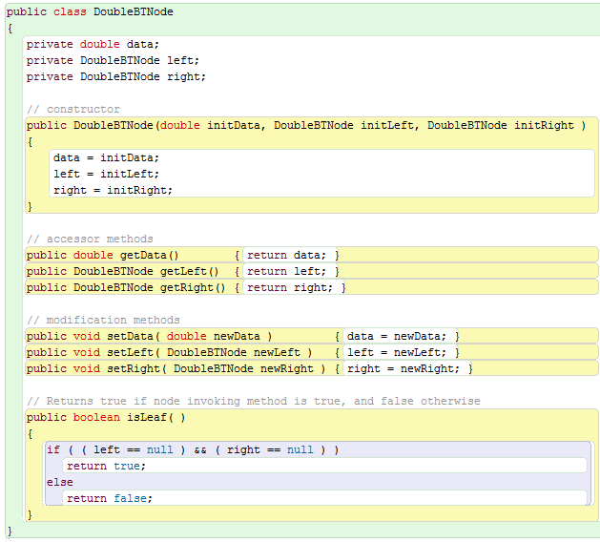
Lab 8 Tree Node Implementation

Slide 15
A Generic Implementation

Slide 16
Binary Search Tree Sample

Slide 17
Nonrecursive BST search algorithm
Set scroll pointer locPtr = root;
Repeat the following:
If locPtr is null return false;
If (value < locPtr.data) locPtr = locPtr.left;
Else if (value > locPtr.data) locPtr = locPtr.right;
Else return true;

Slide 18
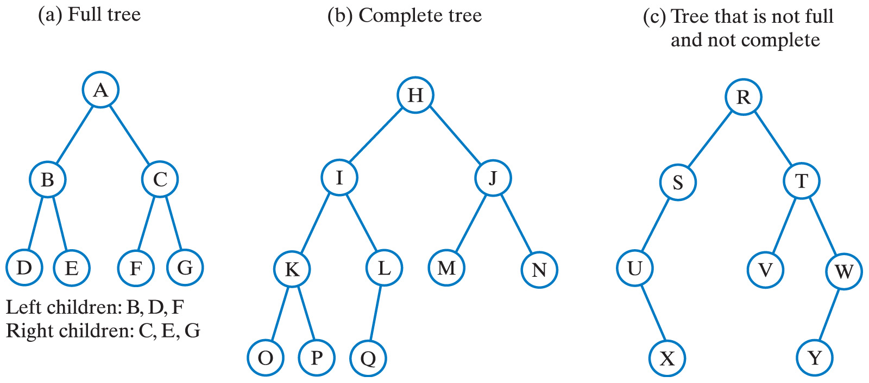
Binary Trees
Each node has at most two children

Slide 19
Now you do it!
Tree warmup worksheet

Slide 20
Tree Terminology review Lecture 16 Starts here. Test Monday!
Nodes at a given level are children of nodes of previous, higher level
Nodes with same parent are siblings
Node with no children is a leaf
Nodes with not of above type (with children) are interior nodes
The only node with no parent is the root
All others have one parent each

Slide 21
Binary Trees
Each node has at most two children

Slide 22
Binary Trees
Every nonleaf in a full binary tree has exactly two children
A complete binary tree is full to its next-to-last level
Leaves on last level filled from left to right

Slide 23
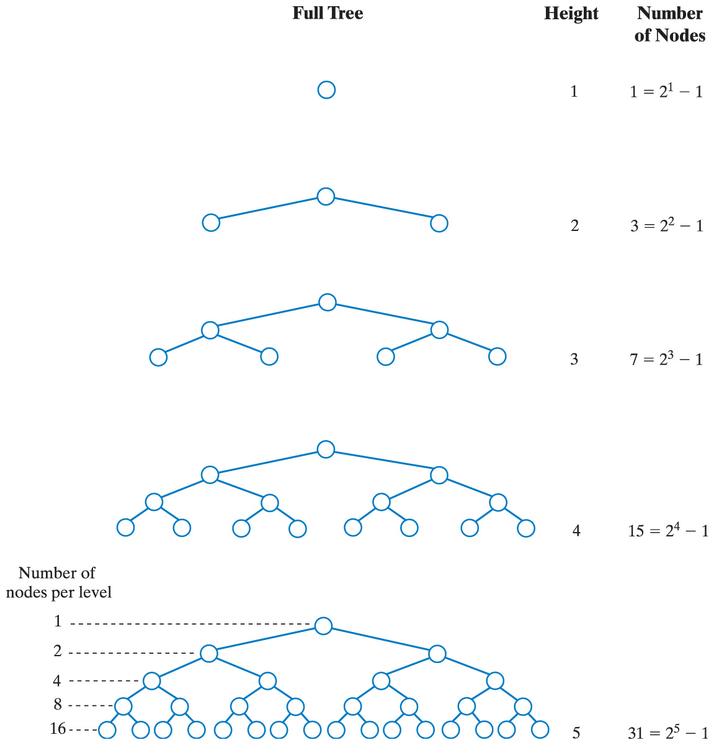
Binary Trees: depth & height
Full Tree Height Number of Nodes
0
Node’s depth: number of edges from root to it.
root node = depth 0.
Tree’s height: largest depth of all nodes in tree.
Root node = height 0.
1
2
The number of nodes in a full binary tree as a function of the tree's height. Some texts have root as depth 1. We will use zero for this course.

Slide 24
Binary Trees
Full Tree Height Number of Nodes
3
4
The number of nodes in a full binary tree as a function of the tree's height.

Slide 25
Traversals of a Tree: Process all nodes in the tree in a systematic order.
Visiting a node
Processing the data within a node
This is the action performed on each node during traversal of a tree
A traversal can pass through a node without visiting it at that moment

Slide 26
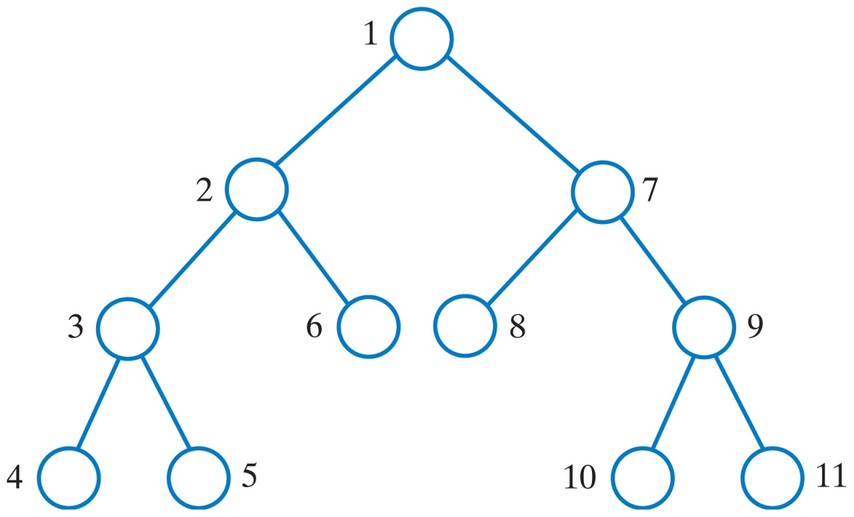
Traversals of a Tree
Preorder traversal: visit current node before the subtrees. Start with root.
1) visit node
2) visit left tree
3) visit right tree
The visitation order of a preorder traversal.

Slide 27
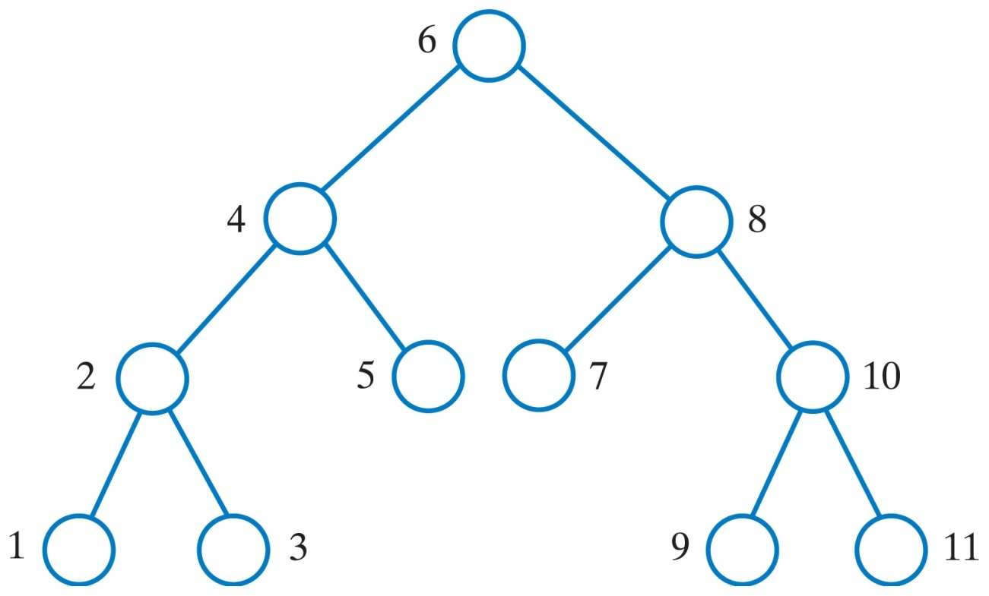
Traversals of a Tree
Inorder traversal: visit root between visiting the subtrees
1) visit left tree
2) visit node
3) visit right tree
The visitation order of an inorder traversal.

Slide 28
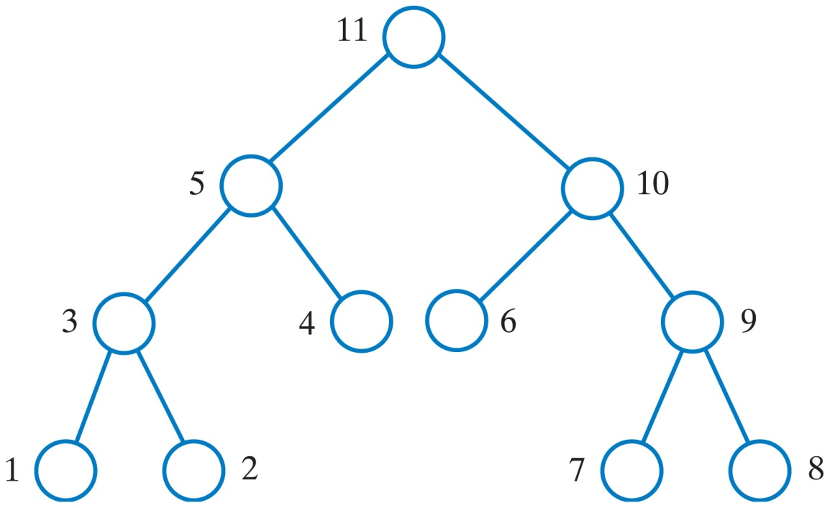
Traversals of a Tree
Postorder traversal: visit root after visiting the subtrees
1) visit left tree
2) visit right tree
3) visit root
These are examples of a depth-first traversal.
The visitation order of a postorder traversal.

Slide 29
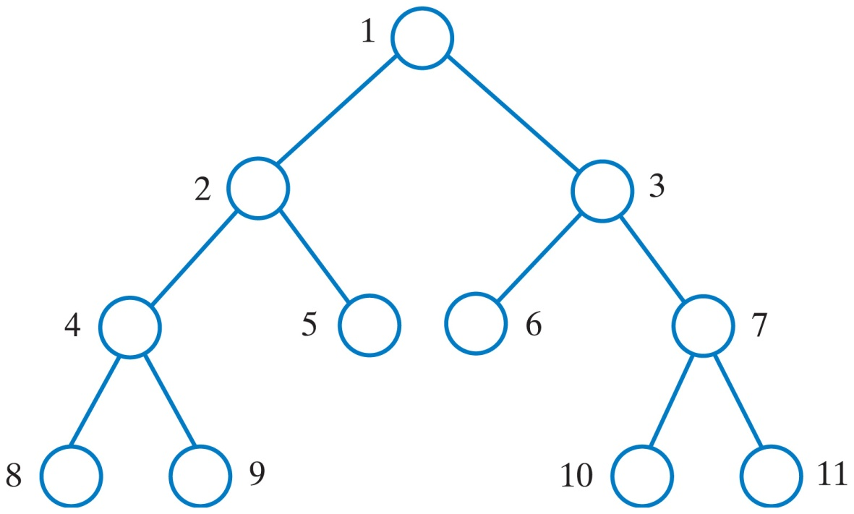
Traversals of a Tree: breadth-first
Level-order traversal: begin at the root, visit nodes one level at a time
This is an example of a breadth-first traversal.
The visitation order of a level-order traversal.

Slide 30
Traversing a Binary Search Tree

Slide 31
Sample traversals

Slide 32
Traversals

Slide 33
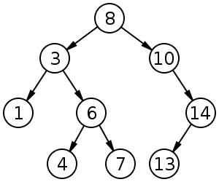
Now you do it!
Inorder: LNR
Order visited:
Preorder: NLR
Order visited:
Postorder: LRN
Order visited:

